Slide 4

模型训练流程 | Model training process
数据采集
数据清洗
数据标注
模型训练
模型测试
Data Collection
Data Cleaning
Data Annotation
Model Training
Model Testing

Slide 6
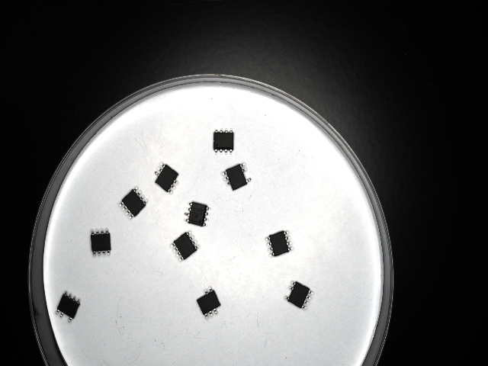
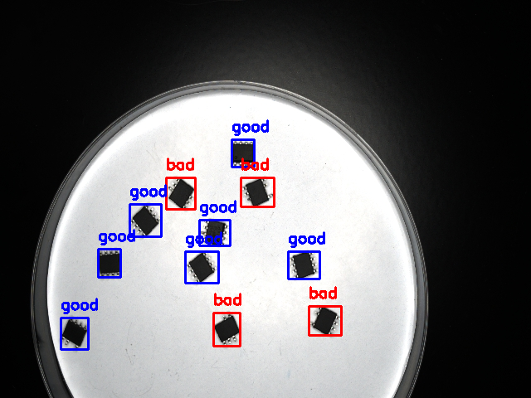
理想测试效果 | The desired test results
Original image
Image after quality inspection

Slide 7
为什么我们自己训练的模型效果不好 | Why do the models we train ourselves perform poorly?
图片数据量小
训练次数少
CPU训练耗时
CPU Training Slow
Small Dataset
Few Training Epochs
训练样本不足，模型泛化能力差
epochs设置较小，模型未充分学习
未使用GPU加速，训练效率低
Insufficient training samples, poor model generalization
Low epoch count, insufficient model learning
No GPU acceleration, low training efficiency
Dataset > 1000
Epochs > 300
GPU, NPU for acceleration

Slide 9
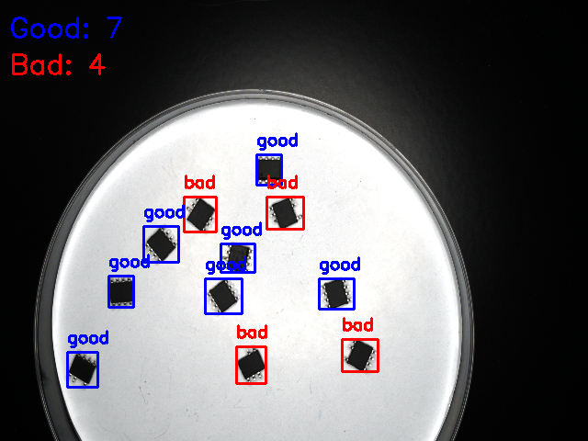
模型训练好了，我们可以用这个模型来干什么？ | The chip quality inspection model is trained, what can we do with this model?
Demo

Slide 11

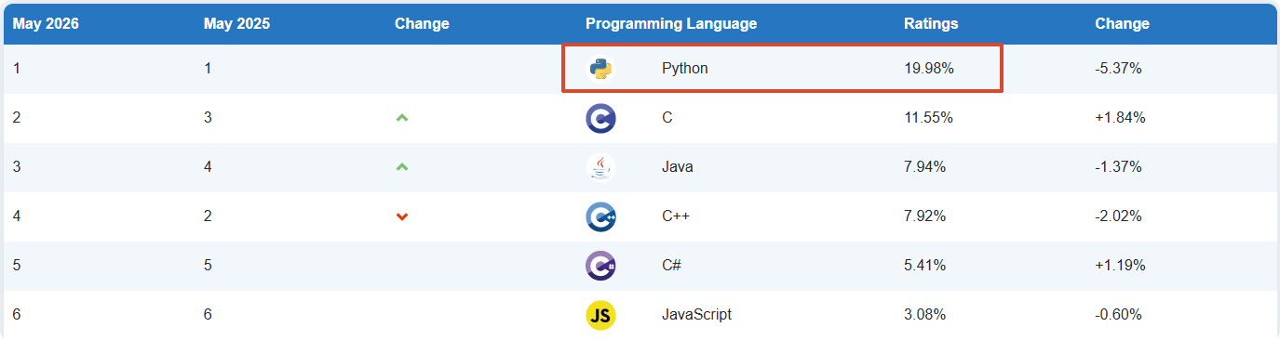

Python 编程 | Python：A programming language
Python is a very popular programming language for AI
TIOBE官网 | TIOBE website：https://www.tiobe.com/tiobe-index

Slide 12


PyCharm集成开发环境 | PyCharm： Used for Python programming and development
简要介绍：一种Python IDE（Integrated Development Environment，集成开发环境），带有一整套开发时提高效率的工具，比如调试、语法高亮、代码跳转、智能提示、单元测试、版本控制等。
官方网址：https://www.jetbrains.com.cn/en-us/pycharm/

Slide 13
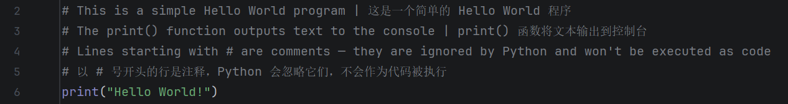
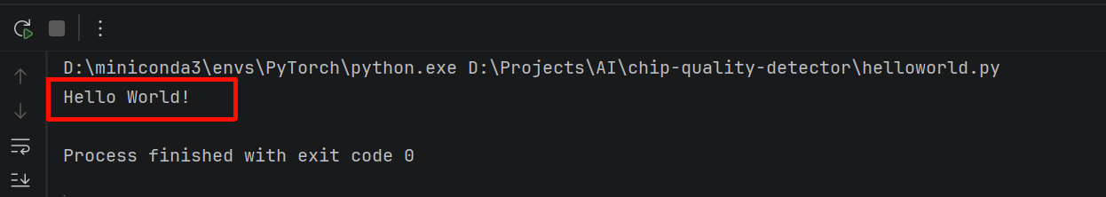
Python编程演示 | Python programming demonstration
第一个程序：输出hello，world！| The first program: output hello, world!

Slide 14
单张图片不同质量芯片数量统计功能编程实现 | Programming implementation of the counting function for chip counts of different qualities in a single image

Slide 15
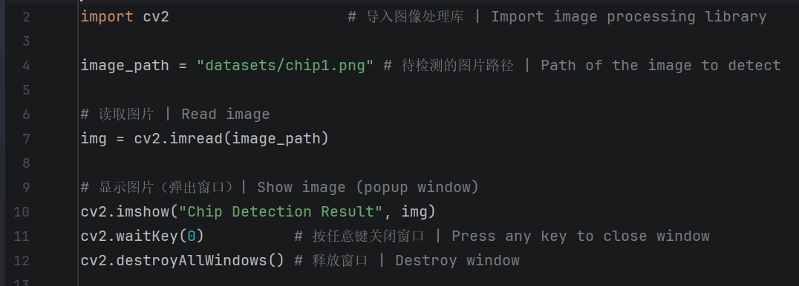
（1）图片显示 | Display the image

Slide 16
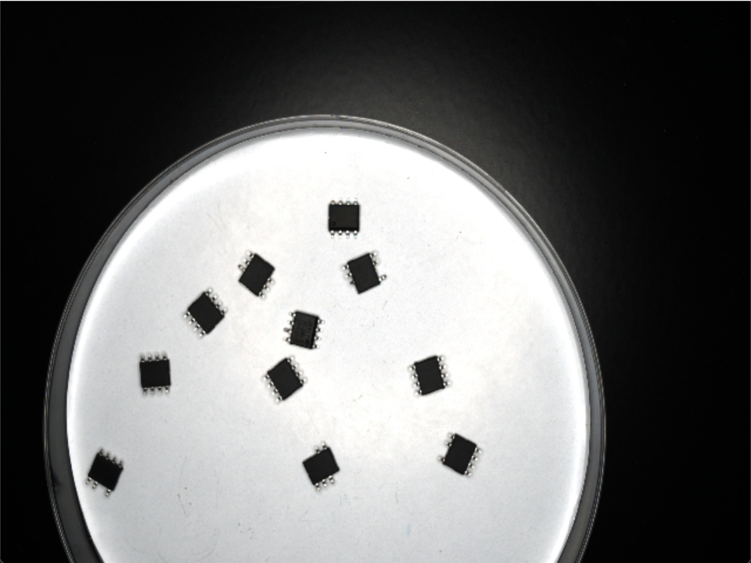
（1）图片显示 | Display the image

Slide 17
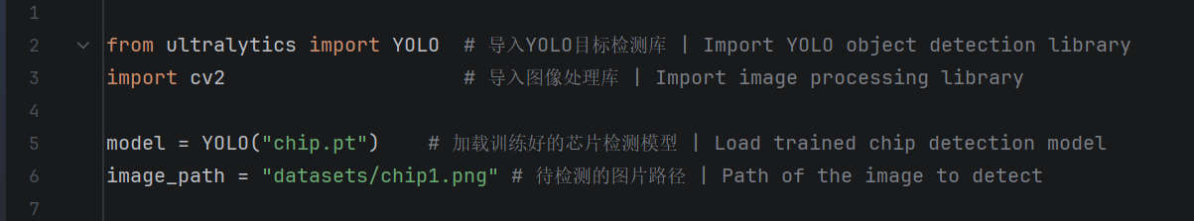
（2）芯片目标检测 | Detect the target position of the chip in the image and draw a box

Slide 18
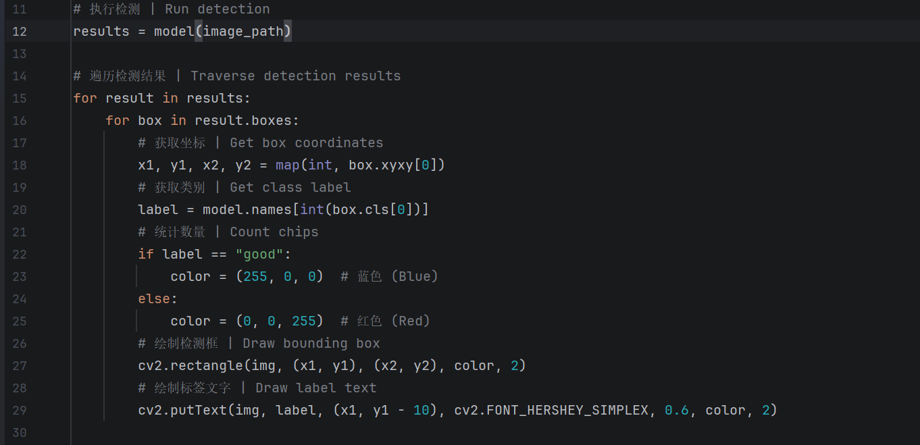
（2）芯片目标检测 | Detect the target position of the chip in the image and draw a box

Slide 19

（2）芯片目标检测 | Detect the target position of the chip in the image and draw a box

Slide 20
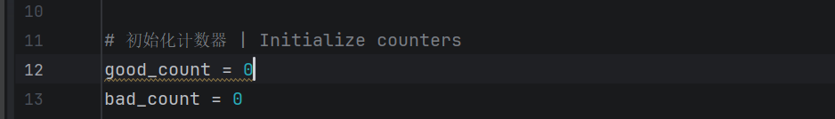
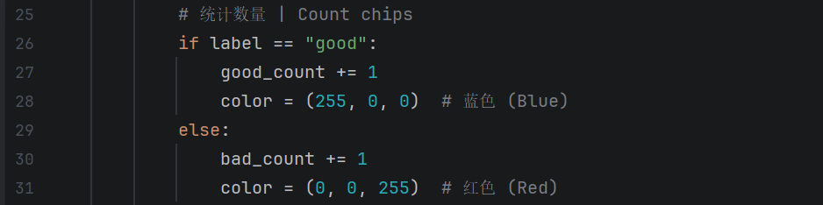
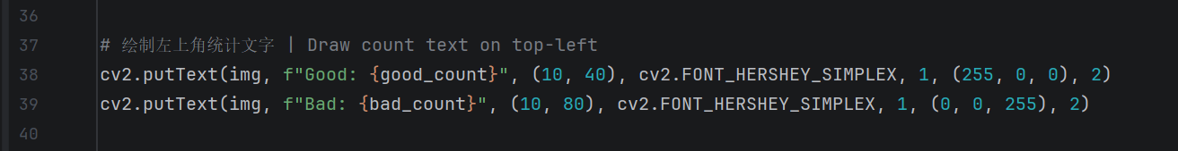
（3）芯片数量统计 | Count the number of chips of different qualities

Slide 21

（3）芯片数量统计 | Count the number of chips of different qualities

Slide 22
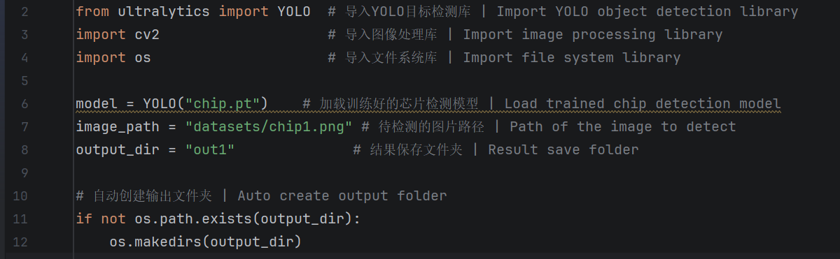

（4）检测结果保存 | Save target detection results

Slide 23
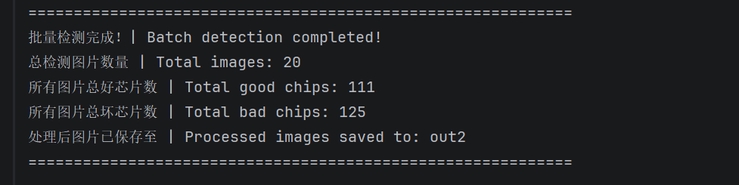
多张图片不同质量芯片数量统计功能编程实现 | A function for programming the statistics of the number of chips of different quality in multiple images
(Foreign access)Github website: https://github.com/whtcc-yuchangle/chip-quality-detector
(Domestic access)Gitee website: https://gitee.com/yuchangle-whtcc/chip-quality-detector

Slide 24
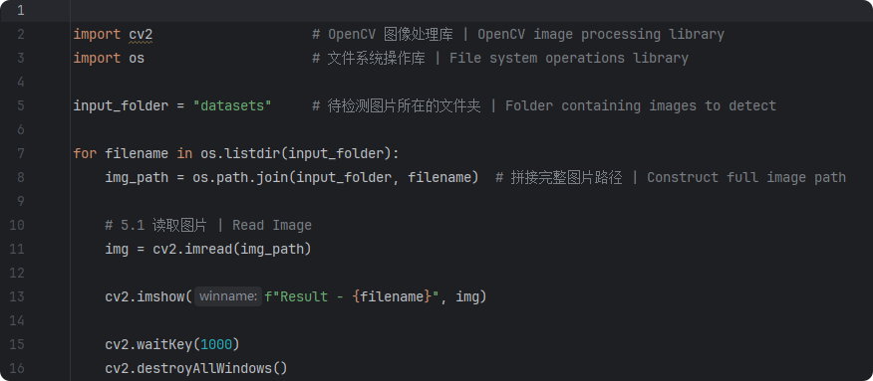
（1）依次显示文件夹中图片 | Display images in the folder sequentially

Slide 25
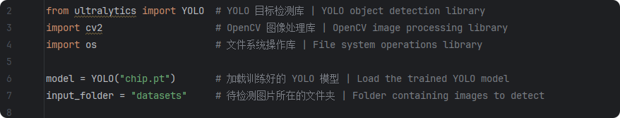
（2）对文件夹中所有图片进行目标检测 | Object detection on all images in the folder

Slide 26
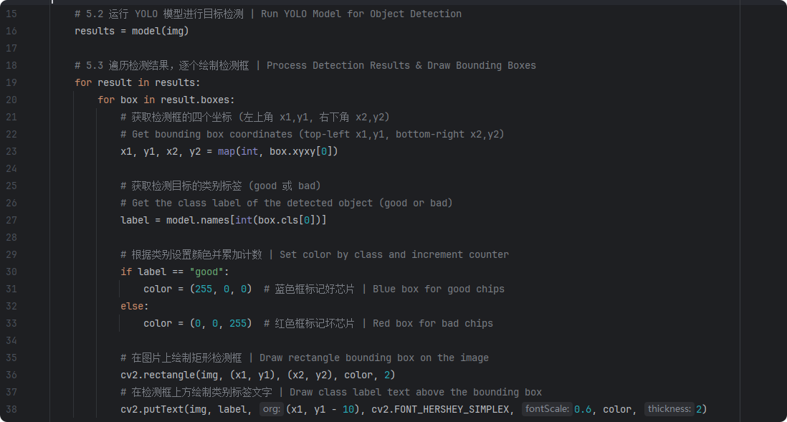
（2）对文件夹中所有图片进行目标检测 | Object detection on all images in the folder

Slide 27
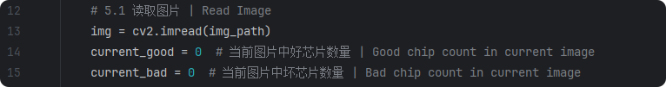

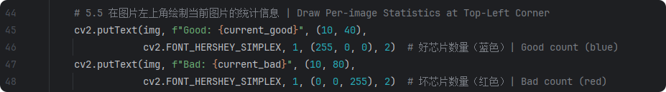
（3）每张图片的芯片数量统计 | Statistics of the number of chips per image

Slide 28
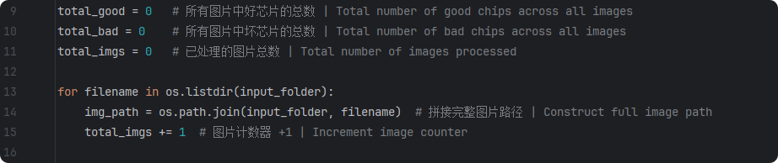

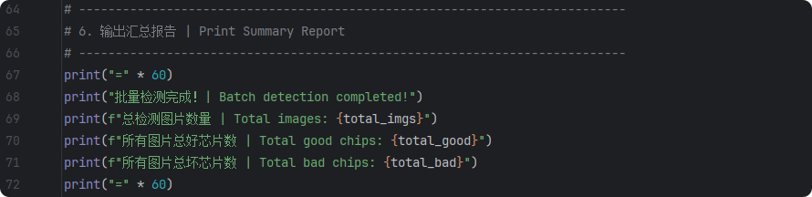
（4）统计结果汇总 | Folder image chip quantity statistics summary

Slide 29
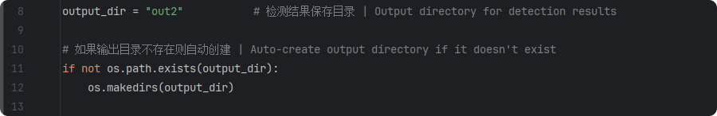

（5）检测结果保存 | Save target detection results

Slide 31
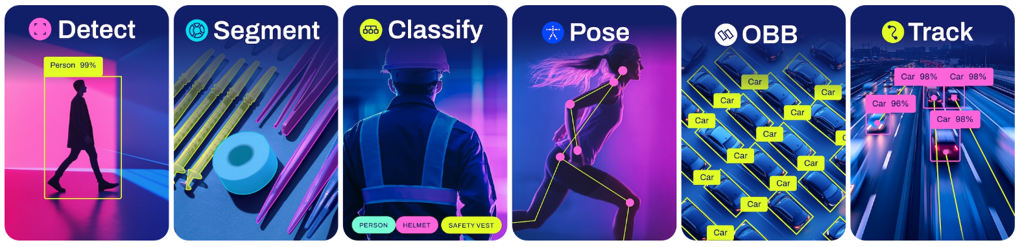
基于计算机视觉的AI模型应用 | AI model applications based on computer vision
目标检测
实例分割
分类检测
姿态估计
方向物体检测
目标追踪

Slide 32
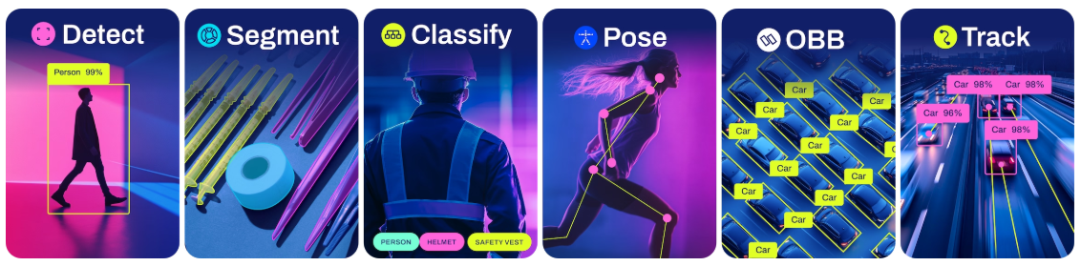
（1）目标检测 | Detect
目标检测

Slide 33
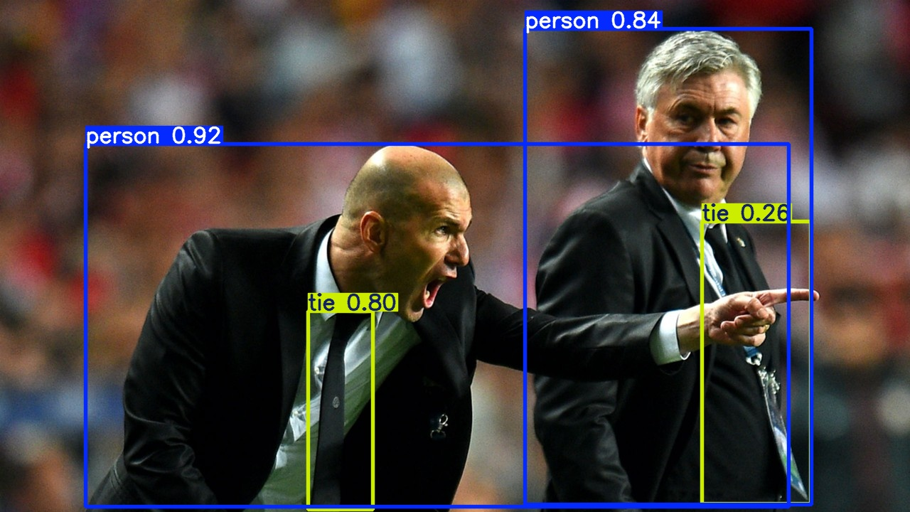
（1）目标检测 | Detect
目标检测

Slide 34
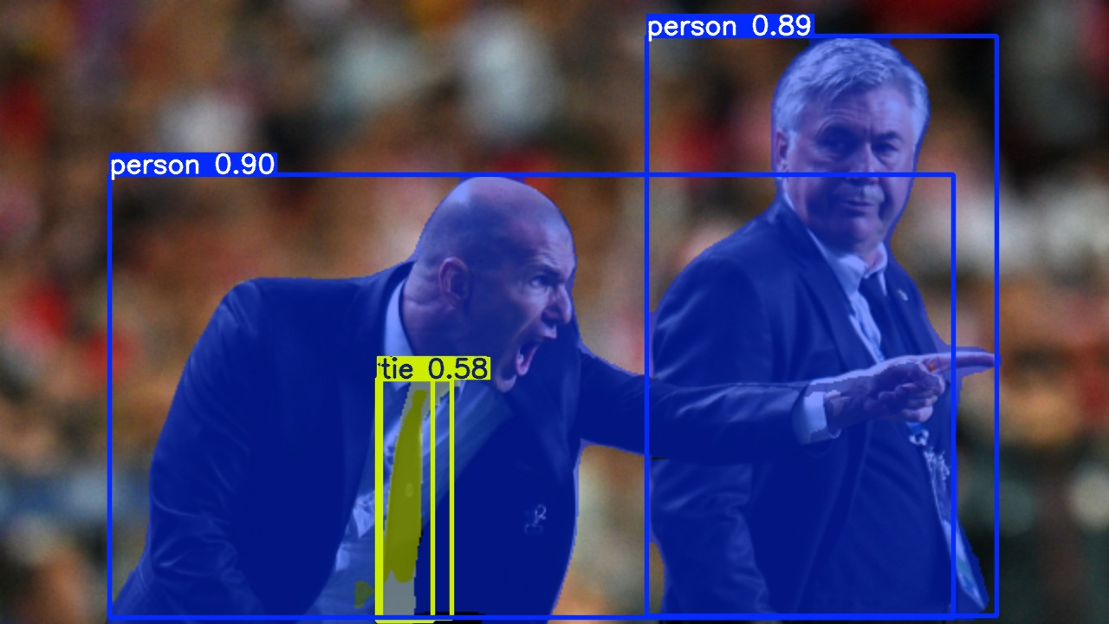
（2）图像分割 | Segment
图像分割

Slide 35
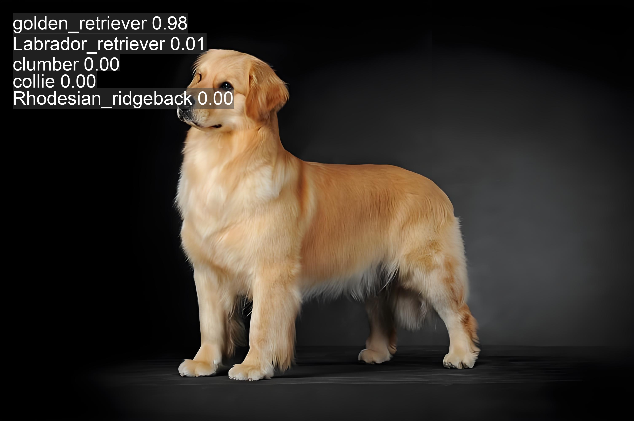
（3）分类检测 | Classify
分类检测

Slide 36
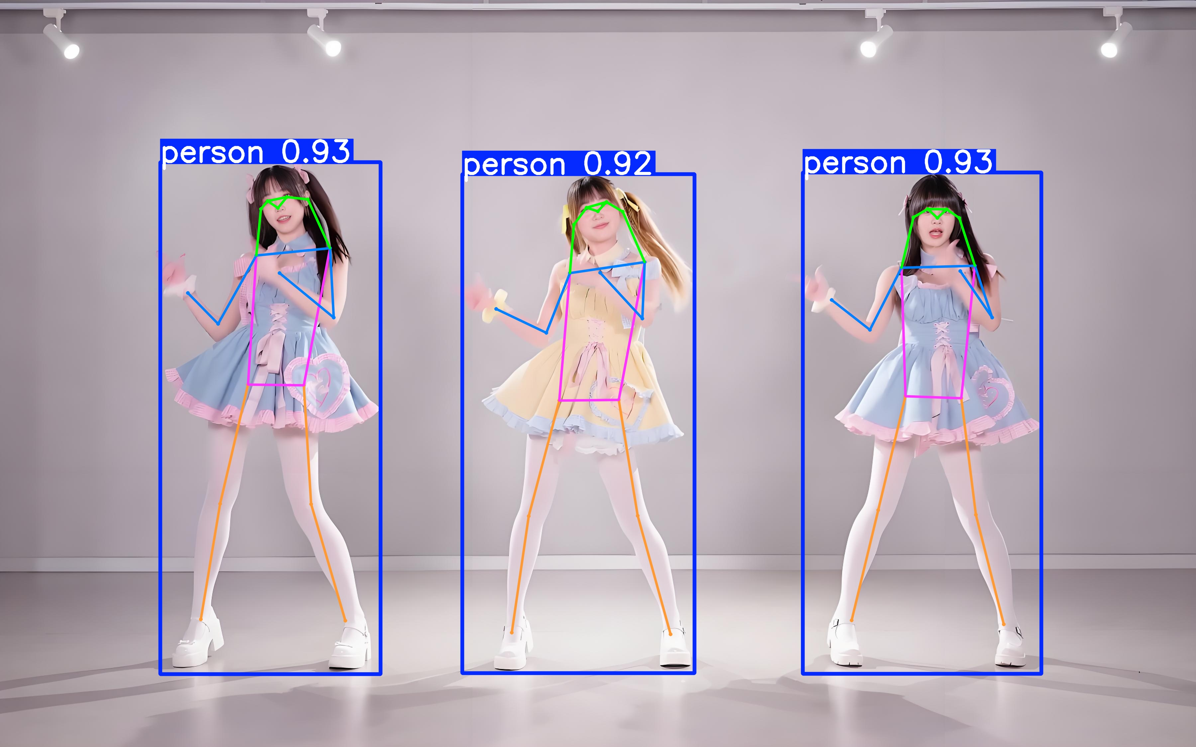
（4）姿态估计 | Pose
姿态估计

Slide 37
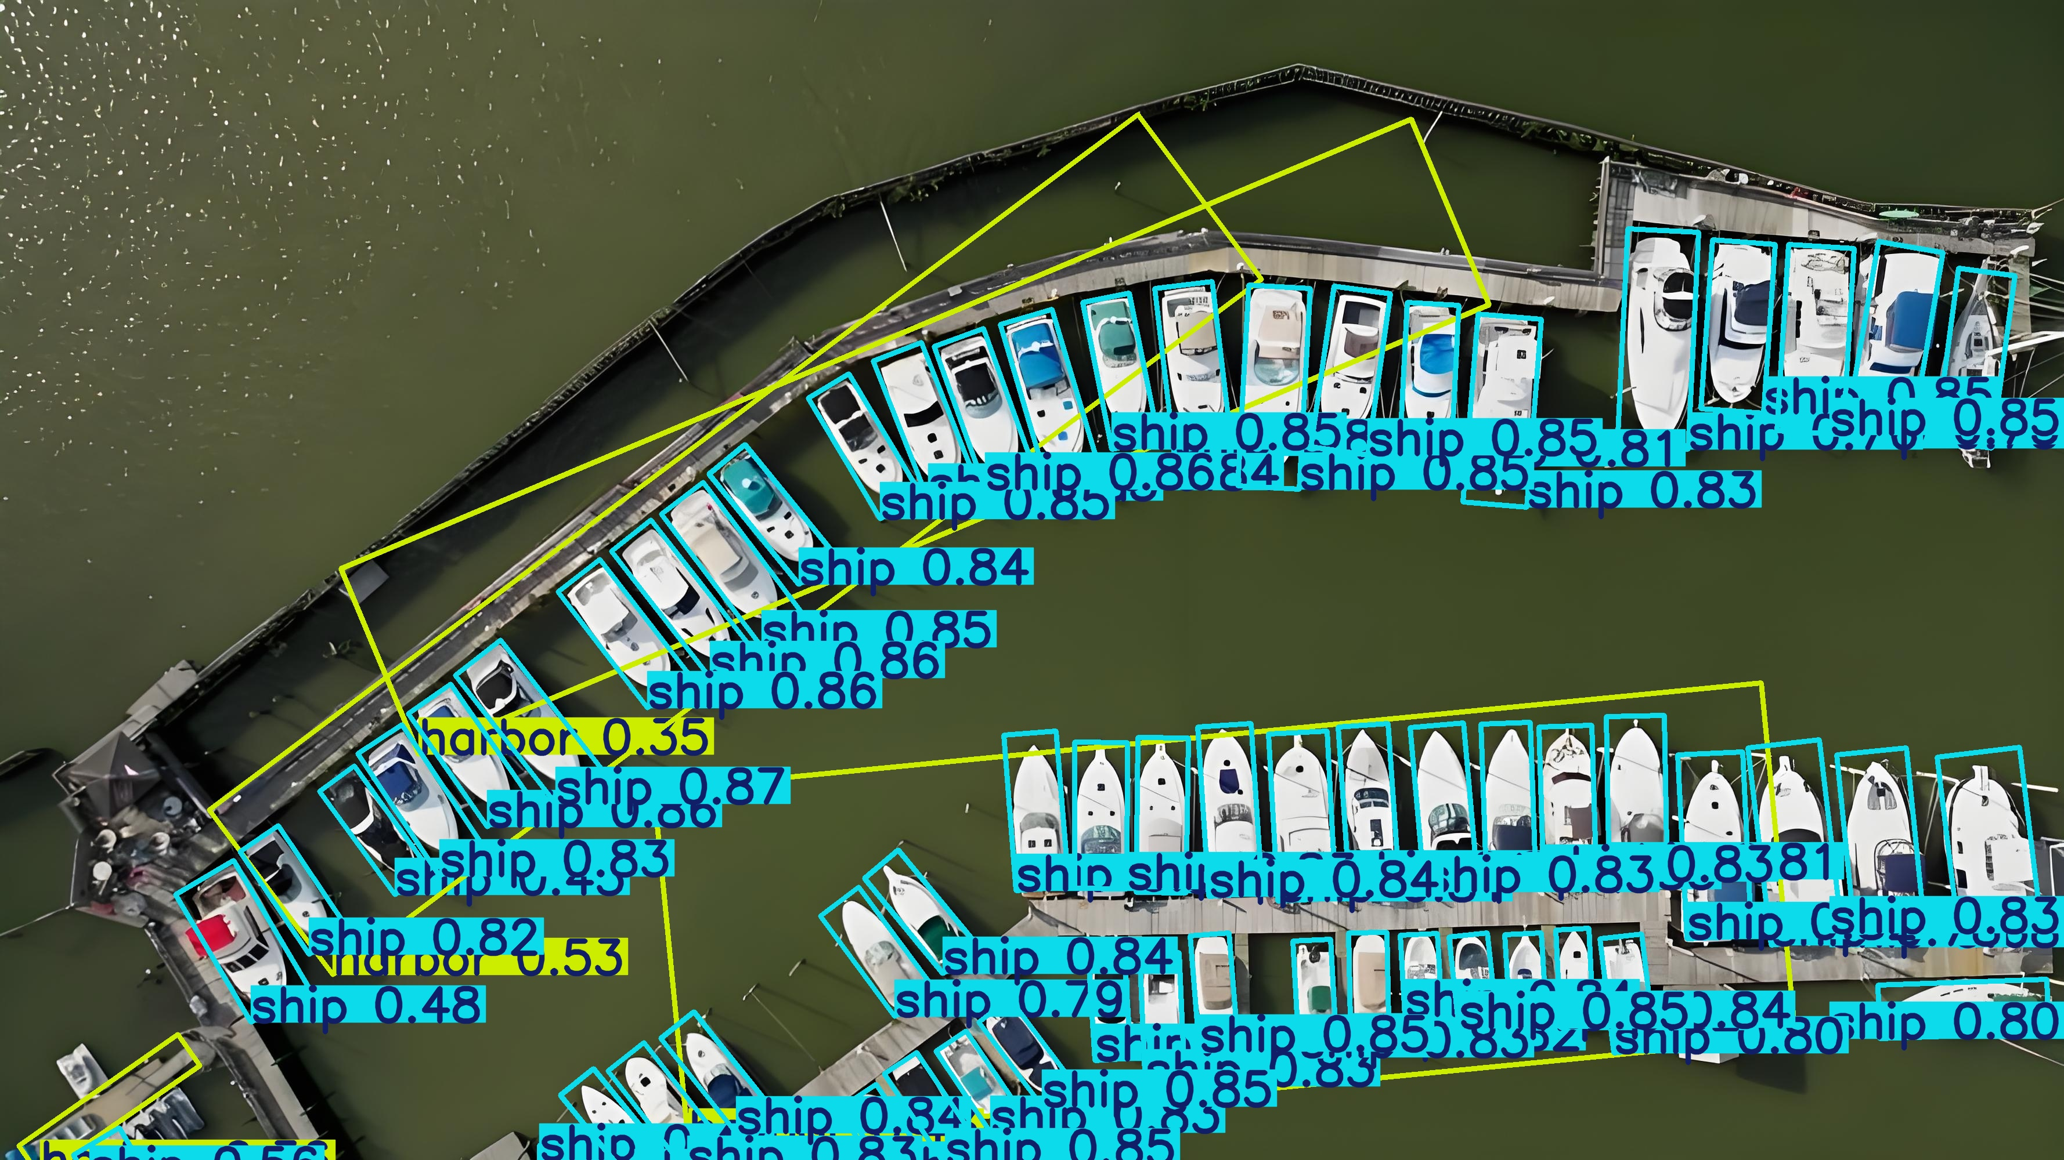
（5）方向物体检测 | OBB
方向物体检测

Slide 38
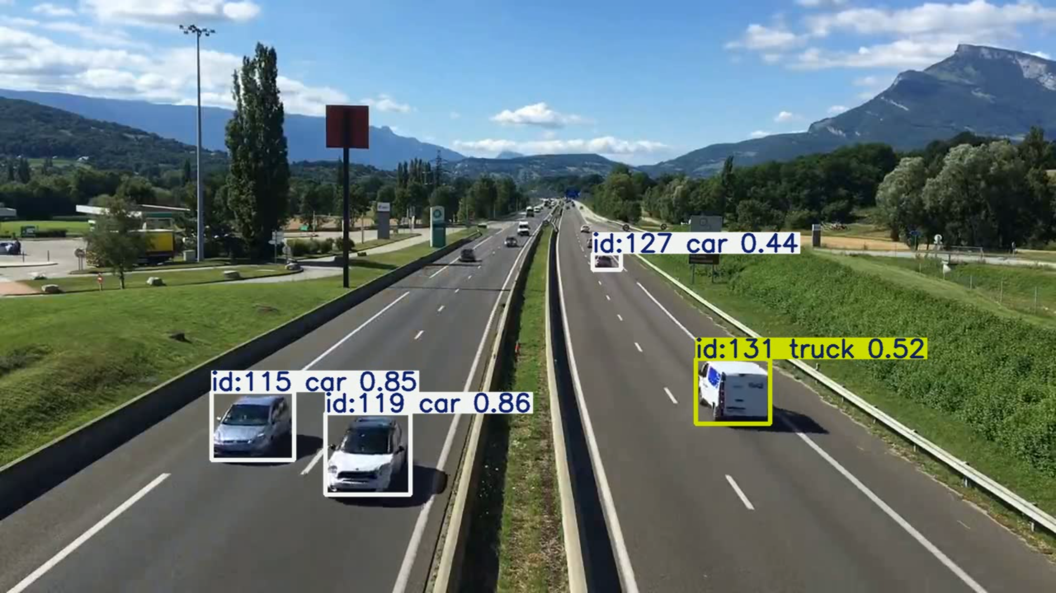
（6）目标追踪 | Track
目标追踪

